Slide 1
OBJECT ORIENTED PROGRAMMING USING JAVA-CST 205
S3 BTECH,CREDITS – 4
COMPUTER SCIENCE AND ENGINEERING DEPARTMENT
MAR ATHANASIUS COLLEGE OF ENGINEERING

Slide 2
COURSE OUTCOMES
1.Write Java programs using the object oriented concepts - classes, objects, constructors, data hiding, inheritance and polymorphism
2. Utilise datatypes, operators, control statements, built in packages & interfaces, Input/ Output Streams and Files in Java to develop programs
3. Illustrate how robust programs can be written in Java using exception handling mechanism
4. Write application programs in Java using multithreading and database connectivity.
5. Write Graphical User Interface based application programs by utilising event handling features and Swing in Java

Slide 3
TEXT BOOKS:
Herbert Schildt, Java: The Complete Reference, 8/e, Tata McGraw Hill, 2011.
Rajib Mall, Fundamentals of Software Engineering, 4th edition, PHI, 2014.
Paul Deitel, Harvey Deitel, Java How to Program, Early Objects 11th Edition, Pearson, 2018.

Slide 4
MODULE 1
Introduction: Approaches to Software Design - Functional Oriented Design, Object Oriented Design, Case Study of Automated Fire Alarm System.
Object Modeling Using Unified Modeling Language (UML) – Basic Object Oriented concepts, UML diagrams, Use case model, Class diagram, Interaction diagram, Activity diagram, State chart diagram.
Introduction to Java - Java programming Environment and Runtime Environment, Development Platforms -Standard, Enterprise. Java Virtual Machine (JVM), Java compiler, Bytecode, Java applet, Java Buzzwords, Java program structure, Comments, Garbage Collection, Lexical Issues.

Slide 5
INTRODUCTION
Software refers to the set of instructions fed in form of programs to govern the computer system and process the hardware components
The antivirus that we use to protect our computer system is a type of Software.
The media players that we use to play multimedia files such as movies, music etc. are Software.
The Microsoft Office we use to edit the documents is a Software.

Slide 6
WHAT IS A GOOD SOFTWARE DESIGN
A good software design should capture all the functionalities of the system correctly
It should be easily understandable
It should be efficient
It should be easily easily maintainable

Slide 7
Software design is a process to transform user requirements into some suitable form, which helps the programmer in software coding and implementation.
Software Design
Function-oriented Design
Object-oriented Design

Slide 8
Function-oriented Design
System is comprised of many smaller sub-systems known as functions
Functions are capable of performing significant tasks in the system
Salient features:
Top-Down Decomposition
Centralised System State

Slide 9
Top Down Decomposition
High level system is decomposed into more detailed functions
Eg- Function : create new_library_member
Assign membership id
create membership record
Print bill
Centralised System State
centralised & shared among different functions
Member records is available for reference & updation to several functions
create new_library_member
delete_member
update_member_record

Slide 10
Dis advantages of Function Oriented Design:
functions are given more importance compared to Data
complexity with respect to global and local variables.
difficult to identify what data is used by which function, in lengthy programs

Slide 11
Object-oriented Design
collection of objects or entities
each object is associated with a set of functions called methods
data internal to an object cannot be accessed directly by other objects
decentralised system, no globally shared data
Eg: Library automation software
Each library member may be a separate object with its own data & functions to operate on stored data

Slide 12



FOD Withdraw( ){sub functions()} Deposit( ) {sub functions()} Transfer( ) {sub functions()} | OOD Customer Money Account

Slide 13
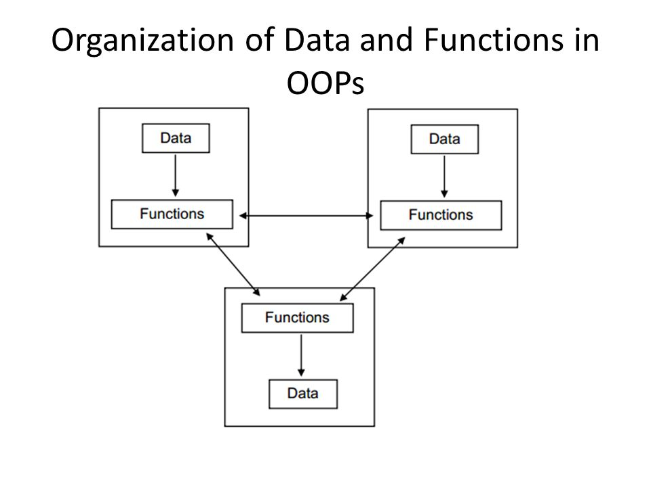

Slide 14
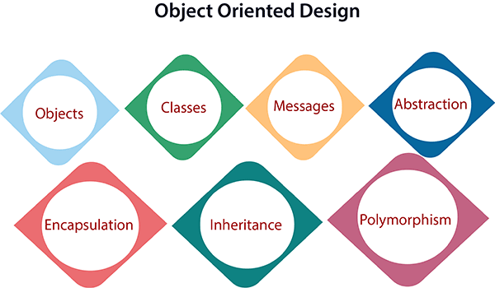

Slide 15
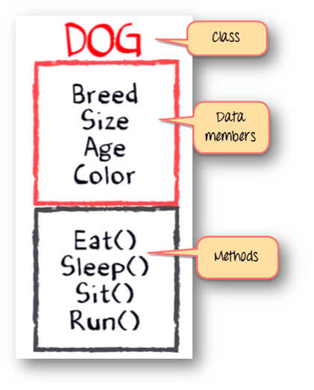
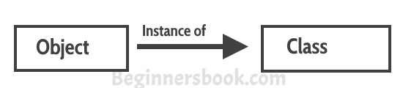
The main aim of OOP is to bind together the data and the functions that operate on them so that no other part of the code can access this data except that function.
Object
Is a bundle of data and its behaviour(often known as methods).

Slide 16
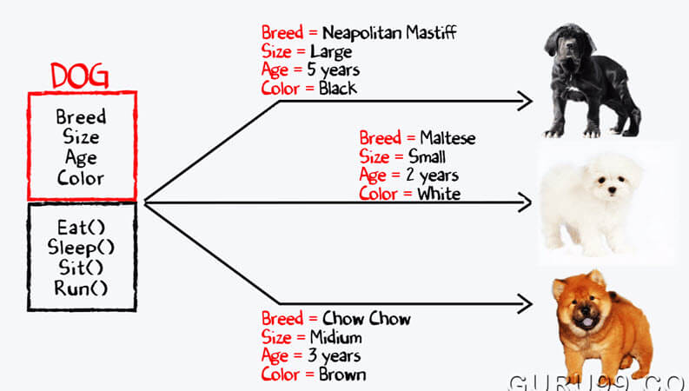

Slide 17
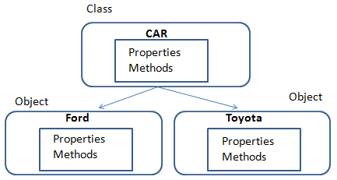
Class
A class is a blueprint or prototype that defines the variables and the methods common to all objects of a certain kind
Entire set of data and code of an object can be made user defined data type with the help of a class

Slide 18
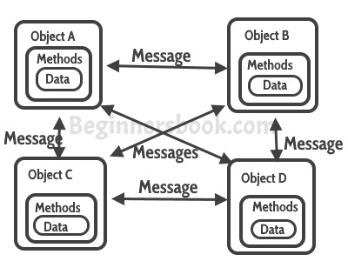
Messages
A single object by itself may not be very useful.
An application contains many objects.
One object interacts with another object by invoking methods on that object.
It is also referred to as Method Invocation.

Slide 19
4. Data Abstraction
Process where only relevant data is shown and irrelevant things are hidden
5. Data Encapsulation
wrapping up of data and functions into a single unit is known as Encapsulation
data is not accessible to the outside world and only those functions which are wrapped in the class can access it
data hiding or information hiding

Slide 20
6. Inheritance
process by which one class acquires the properties and functionalities of another class is called inheritance.
reusability of code
each sub class defines only those features that are unique to it, rest of the features can be inherited from the parent class.

Slide 21
7. Polymorphism
ability of a message to be displayed in more than one form
allow one name to be used to specify a general class of actions
within a general class of actions, the specific action to apply in any particular instance is determined by the type of data involved

Slide 22
CASE STUDY – Fire Alarm System
The owner of a large multi-stored building wants to have a computerized fire alarm system for his building. Smoke detectors and fire alarms would be placed in each room of the building. The fire alarm system would monitor the status of these smoke detectors. Whenever a fire condition is reported by any of the smoke detectors, the fire alarm system should determine the location at which the fire condition is reported by any of the smoke detectors, the fire alarm system should determine the location at which the fire condition has occurred and then sound the alarms only in the neighbouring locations. The fire alarm system should also flash an alarm message on the computer console. Fire fighting personnel man the console round the clock. After a fire condition has been successfully handled, the fire alarm system should support resetting the alarms by the fire fighting personnel.

Slide 23
Function-Oriented Approach
/* Global data (system state) accessible by various functions */
BOOL detector_status[MAX_ROOMS];
int detector_locs[MAX_ROOMS];
BOOL alarm_status[MAX_ROOMS]; /* alarm activated when status is set */
int alarm_locs[MAX_ROOMS]; /* room number where alarm is located */
int neighbor-alarm[MAX_ROOMS][10]; /* each detector has at most 10 neighboring locations */
The functions which operate on the system state are:
interrogate_detectors();
get_detector_location();
determine_neighbor();
ring_alarm();
reset_alarm();
report_fire_location()

Slide 24
Object-Oriented Approach:
class detector
attributes:
status, location, neighbors
operations:
create, sense_status, get_location, find_neighbors
class alarm
attributes:
location, status
operations:
create, ring_alarm, get_location, reset_alarm

Slide 25
OBJECT MODELLING USING UML
Transform user requirements into some suitable form, which helps the programmer in software coding and implementation
Unified Modeling Language (UML) is a general purpose modelling language.
visualize the way a system has been designed.
not a programming language
behavior and structure of a system
UML helps software engineers, businessmen and system architects with modelling, design and analysis

Slide 26
Object-Oriented Concepts
UML can be described as the successor of object-oriented (OO) analysis and design
An object contains both data and methods that control the data
The data represents the state of the object
A class describes an object and they also form a hierarchy to model the real-world system
UML is powerful enough to represent all the concepts that exist in object-oriented analysis and design
UML diagrams are representation of object-oriented concepts only

Slide 27
Following are some fundamental concepts of the object-oriented world :
Class – A class defines the blue print i.e. structure and functions of an object.
Objects – Objects help us to decompose large systems and help us to modularize our system. An object is the fundamental unit (building block) of a system which is used to depict an entity.
Inheritance – Inheritance is a mechanism by which child classes inherit the properties of their parent classes.
Abstraction – Mechanism by which implementation details are hidden from user.
Encapsulation – Binding data together and protecting it from the outer world is referred to as encapsulation.
Polymorphism – Mechanism by which functions or entities are able to exist in different forms

Slide 28
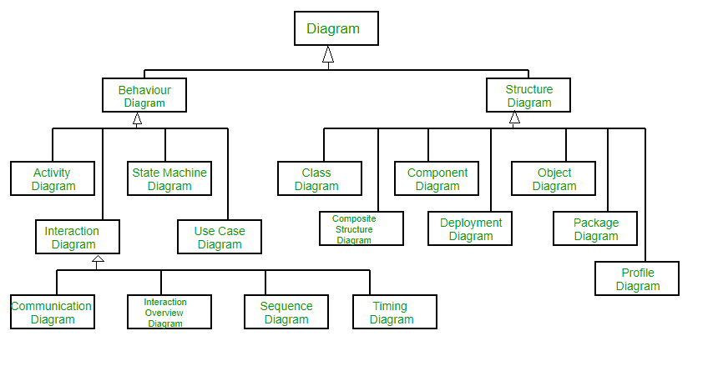

Slide 29
Structural Diagrams – Capture static aspects or structure of a system.
Component Diagrams, Object Diagrams, Class Diagrams and Deployment Diagrams.
Behavior Diagrams – Capture dynamic aspects or behavior of the system.
Use Case Diagrams, State Diagrams, Activity Diagrams and Interaction Diagrams.

Slide 30
UML DIAGRAMS | Use case Model
 | Class Diagram
 | Interaction Diagram
 | Activity Diagram
 | State chart Diagram

Slide 31
USE CASE MODEL
describes a system's functional requirements in terms of use cases.
a model of the system's intended functionality (use cases) and its environment (actors).
Use cases enables to relate to whats need from a system to how the system delivers on those needs.
use-case model as a restaurant menu

Slide 32
Purpose of Use Case Diagram
Specify the context of a system
Capture the requirements of a system
Validate a systems architecture
Drive implementation and generate test cases
Developed by analysts together with domain experts

Slide 33
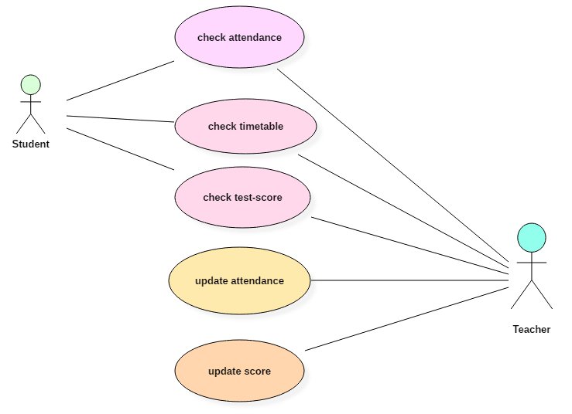
Notes:
here are two actors named student and a teacher. There are a total of five use cases that represent the specific functionality of a student management system. Each actor interacts with a particular use case. A student actor can check attendance, timetable as well as test marks on the application or a system. This actor can perform only these interactions with the system even though other use cases are remaining in the system.
It is not necessary that each actor should interact with all the use cases, but it can happen.
The second actor named teacher can interact with all the functionalities or use cases of the system. This actor can also update the attendance of a student and marks of the student. These interactions of both student and a teacher actor together sums up the entire student management application.

Slide 34
Actor
Someone interacts with use case (system function).
Named by noun.
Actor plays a role in the business
Similar to the concept of user, but a user can play different roles
For example:
A prof. can be instructor and also researcher
plays 2 roles with two systems
Actor triggers use case(s).
Actor has a responsibility toward the system (inputs), and Actor has expectations from the system (outputs).

Slide 35
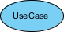
Use Case
System function (process - automated or manual)
Named by verb + Noun (or Noun Phrase).
i.e. Do something
Each Actor must be linked to a use case, while some use cases may not be linked to actors.

Slide 36
Communication Link
The participation of an actor in a use case is shown by connecting an actor to a use case by a solid link.
Actors may be connected to use cases by associations, indicating that the actor and the use case communicate with one another using messages.

Slide 37
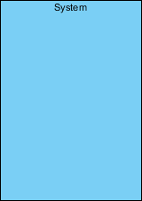
Boundary of system
The system boundary is potentially the entire system as defined in the requirements document.

Slide 38
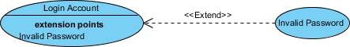
Use Case Relationship 🡪 extends
Indicates that an "Invalid Password" use case may include (subject to specified in the extension) the behavior specified by base use case "Login Account”

Slide 39
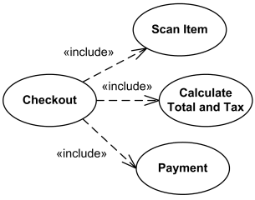
Include
Is a directed relationship between two use cases which is used to show that behavior of the included use case (the addition) is inserted into the behavior of the including (the base) use case.
to simplify large use case by splitting it into several use cases,
to extract common parts of the behaviors of two or more use cases.

Slide 40
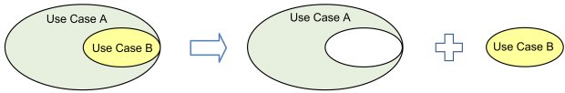
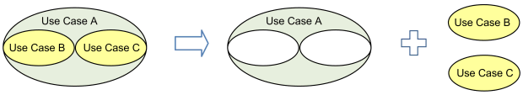
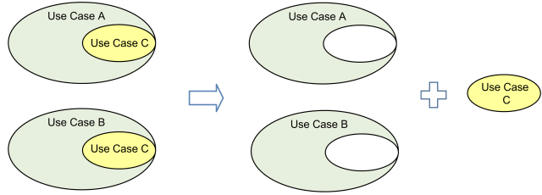

Slide 41
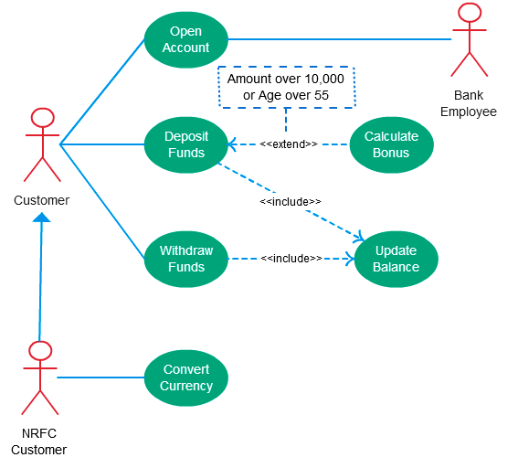

Slide 42
Generalization
A generalization relationship is a parent-child relationship between use cases.
The child use case is an enhancement of the parent use case.
Generalization is shown as a directed arrow with a triangle arrowhead.
The child use case is connected at the base of the arrow.
The tip of the arrow is connected to the parent use case.

Slide 43
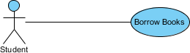
Use Case Example - Association Link
A Use Case diagram illustrates a set of use cases for a system, i.e. the actors and the relationships between the actors and use cases.

Slide 44
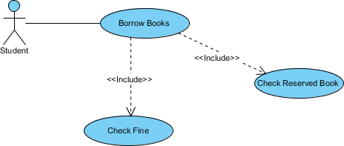
Use Case Example - Include Relationship
The include relationship adds additional functionality not specified in the base use case.
The <<Include>> relationship is used to include common behavior from an included use case into a base use case in order to support the reuse of common behavior.

Slide 45
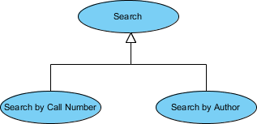
Use Case Example - Generalization Relationship
A generalization relationship means that a child use case inherits the behavior and meaning of the parent use case.
The child may add or override the behavior of the parent.
The figure below provides a use case example by showing two generalization connectors that connect between the three use cases.

Slide 46
CLASS DIAGRAM
type of static structure diagram that describes the structure of a system by showing the system's classes, their attributes, operations (or methods), and the relationships among objects.
A UML class diagram is made up of:
A set of classes and
A set of relationships between classes

Slide 47
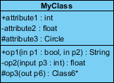
CLASS NOTATION | Class Name | The name of the class appears in the first partition.
 | Class Attributes | Attributes are shown in the second partition. The attribute type is shown after the colon. Attributes map onto member variables (data members) in code.
 | Class Operations (Methods) | They are services the class provides. The return type of a method is shown after the colon at the end of the method signature. The return type of method parameters is shown after the colon following the parameter name.

Slide 48
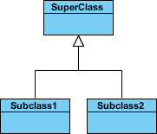
Class Relationships
A class may be involved in one or more relationships with other classes
Relationship Type | Description | Graphical Representation
Inheritance (or Generalization) | Represents an "is-a" relationship. SubClass1 and SubClass2 are specializations of Super Class. A solid line with a hollow arrowhead that point from the child to the parent class

Slide 49
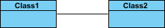
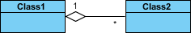
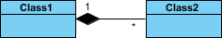
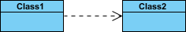
Relationship Type | Description | Graphical Representation
Simple Association | A structural link between two peer classes. There is an association between Class1 and Class2
Aggregation | A special type of association. It represents a "part of" relationship. Class2 is part of Class1. Many instances (denoted by the *) of Class2 can be associated with Class1. Objects of Class1 and Class2 have separate lifetimes.
Composition | A special type of aggregation where parts are destroyed when the whole is destroyed. Objects of Class2 live and die with Class1. Class2 cannot stand by itself.
Dependency | Exists between two classes if the changes to the definition of one may cause changes to the other (but not the other way around). Class1 depends on Class2

Slide 50
Visibility of the attribute and operation.
+ denotes public attributes or operations
- denotes private attributes or operations
# denotes protected attributes or operations
~ denotes package attributes or operations
attribute1 and op1 of MyClassName are public
attribute3 and op3 are protected
attribute2 and op2 are private.

Slide 51
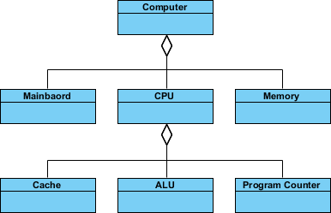
Aggregation Example - Computer and parts
An aggregation is a special case of association denoting a "consists-of" hierarchy
The aggregate is the parent class, the components are the children classes

Slide 52
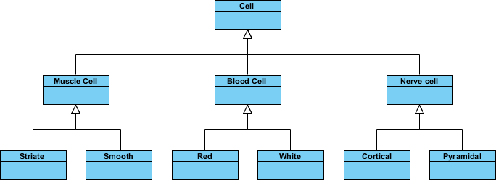
Inheritance Example - Cell Taxonomy
Inheritance is another special case of an association denoting a "kind-of" hierarchy
Inheritance simplifies the analysis model by introducing a taxonomy
The child classes inherit the attributes and operations of the parent class.

Slide 53
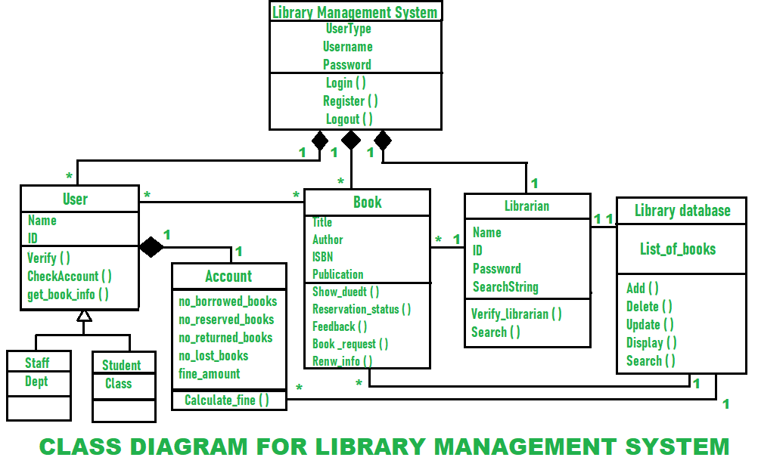
Notes:
Classes of Library Management System :
Library Management System class – It manages all operations of Library Management System. It is central part of organization for which software is being designed.
User Class – It manages all operations of user.
Librarian Class – It manages all operations of Librarian.
Book Class – It manages all operations of books. It is basic building block of system.
Account Class – It manages all operations of account.
Library database Class – It manages all operations of library database.
Staff Class – It manages all operations of staff.
Student Class – It manages all operations of student.
Attributes of Library Management System :
Library Management System Attributes – UserType, Username, Password
User Attributes – Name, Id
Librarian Attributes – Name, Id, Password, SearchString
Book Attributes – Title, Author, ISBN, Publication
Account Attributes – no_borrowed_books, no_reserved_books, no_returned_books, no_lost_books fine_amount
Library database Attributes – List_of_books
Staff Class Attributes – Dept
Student Class Attributes – Class
Methods of Library Management System :
Library Management System Methods – Login(), Register(), Logout()
User Methods – Verify(), CheckAccount(), get_book_info()
Librarian Methods – Verify_librarian(), Search()
Book Methods – Show_duedt(), Reservation_status(), Feedback(), Book_request(), Renew_info()
Account Methods – Calculate_fine()
Library database Methods – Add(), Delete(), Update(), Display(), Search()

Slide 54
INTERACTION DIAGRAM
Used in UML to establish communication between objects
Interaction diagrams mostly focus on message passing and how these messages make up one functionality of a system
Interaction diagrams are designed to display how the objects will realize the particular requirements of a system
Notes:
INTERACTION DIAGRAM are used in UML to establish communication between objects. It does not manipulate the data associated with the particular communication path. Interaction diagrams mostly focus on message passing and how these messages make up one functionality of a system. Interaction diagrams are designed to display how the objects will realize the particular requirements of a system. The critical component in an interaction diagram is lifeline and messages.

Slide 55
Different types of interaction diagrams defined in UML:
Sequence diagram
Collaboration diagram (Communication Diagram)
Timing diagram

Slide 56
A SEQUENCE DIAGRAM simply depicts interaction between objects in a sequential order.
purpose - to visualize the sequence of a message flow in the system.
shows the interaction between two lifelines as a time-ordered sequence of events.

Slide 57
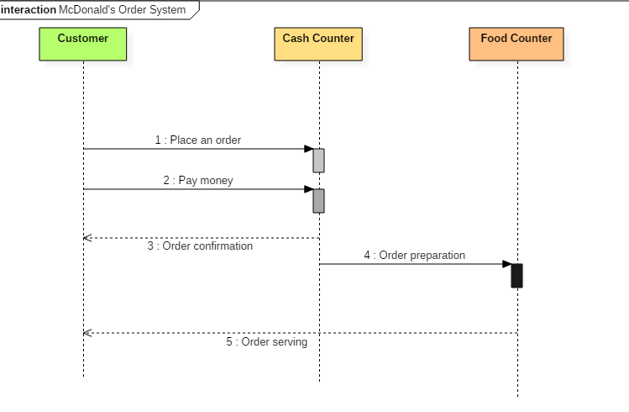

Slide 58
The ordered sequence of events in a given sequence diagram is as follows:
Place an order.
Pay money to the cash counter.
Order Confirmation.
Order preparation.
Order serving.
Notes:
The ordered sequence of events in a given sequence diagram is as follows:
Place an order.
Pay money to the cash counter.
Order Confirmation.
Order preparation.
Order serving.
If one changes the order of the operations, then it may result in crashing the program. It can also lead to generating incorrect or buggy results. Each sequence in the above-given sequence diagram is denoted using a different type of message. One cannot use the same type of message to denote all the interactions in the diagram because it creates complications in the system.
You must be careful while selecting the notation of a message for any particular interaction. The notation must match with the particular sequence inside the diagram.
Benefits of a Sequence Diagram
Sequence diagrams are used to explore any real application or a system.
Sequence diagrams are used to represent message flow from one object to another object.
Sequence diagrams are easier to maintain.
Sequence diagrams are easier to generate.
Sequence diagrams can be easily updated according to the changes within a system.
Sequence diagram allows reverse as well as forward engineering.
Drawbacks of a sequence diagram
Sequence diagrams can become complex when too many lifelines are involved in the system.
If the order of message sequence is changed, then incorrect results are produced.
Each sequence needs to be represented using different message notation, which can be a little complex.
The type of message decides the type of sequence inside the diagram.

Slide 59
Benefits of a Sequence Diagram
Sequence diagrams are used to explore any real application or a system.
Sequence diagrams are used to represent message flow from one object to another object.
Sequence diagrams are easier to maintain.
Sequence diagrams are easier to generate.
Sequence diagrams can be easily updated according to the changes within a system.
Sequence diagram allows reverse as well as forward engineering.

Slide 60
Drawbacks of a sequence diagram
Sequence diagrams can become complex
If the order of message sequence is changed, then incorrect results are produced.
Each sequence needs to be represented using different message notation, which can be a little complex.
The type of message decides the type of sequence inside the diagram.

Slide 61
2. COLLABORATION DIAGRAM depicts the relationships and interactions among software objects.
They are used to understand the object architecture within a system rather than the flow of a message as in a sequence diagram

Slide 62
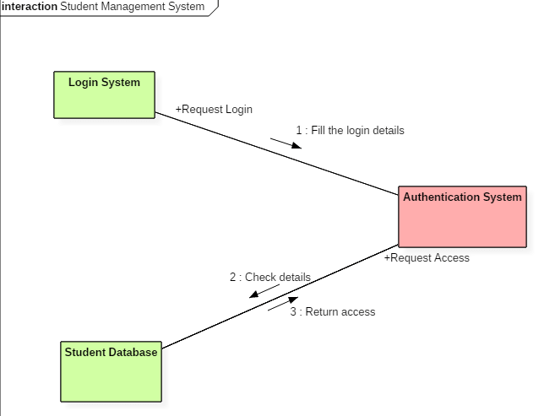
Notes:
The above collaboration diagram represents a student information management system. The flow of communication in the above diagram is given by,
A student requests a login through the login system.
An authentication mechanism of software checks the request.
If a student entry exists in the database, then the access is allowed; otherwise, an error is returned.

Slide 63
Benefits of Collaboration Diagram
It emphasizes the structural aspects of an interaction diagram - how lifeline connects.
Its syntax is similar to that of sequence diagram except that lifeline don't have tails.
Messages passed over sequencing is indicated by numbering each message hierarchically.
Compared to the sequence diagram communication diagram is semantically weak.
Object diagrams are special case of communication diagram.
It allows you to focus on the elements rather than focusing on the message flow as described in the sequence diagram.
Sequence diagrams can be easily converted into a collaboration diagram as collaboration diagrams are not very expressive.
While modeling collaboration diagrams w.r.t sequence diagrams, some information may be lost

Slide 64
Drawbacks of a Collaboration Diagram
Collaboration diagrams can become complex when too many objects are present within the system.
It is hard to explore each object inside the system.
Collaboration diagrams are time consuming.
The object is destroyed after the termination of a program.
The state of an object changes momentarily, which makes it difficult to keep track of every single change the occurs within an object of a system.

Slide 65
3. TIMING DIAGRAM is a waveform or a graph that is used to describe the state of a lifeline at any instance of time.
denote the transformation of an object from one form into another form.
does not contain notations as required in the sequence and collaboration diagram.
The flow between the software program at various instances of time is represented using a waveform.

Slide 66
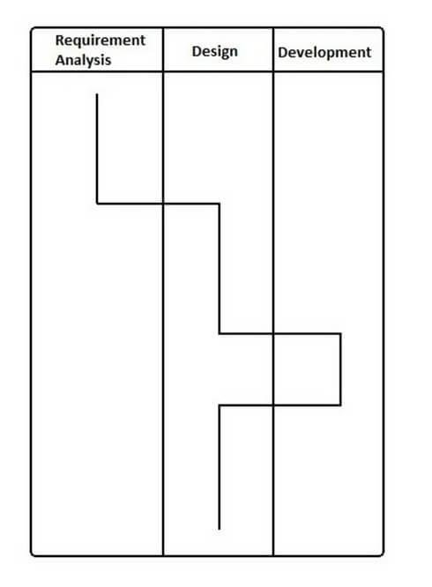
Notes:
In the above diagram, first, the software passes through the requirements phase then the design and later the development phase. The output of the previous phase at that given instance of time is given to the second phase as an input. Thus, the timing diagram can be used to describe SDLC (Software Development Life Cycle) in UML.

Slide 67
Benefits of a Timing Diagram
Timing diagrams are used to represent the state of an object at a particular instance of time.
Timing diagram allows reverse as well as forward engineering.
Timing diagram can be used to keep track of every change inside the system.
Drawbacks of a Timing Diagram
Timing diagrams are difficult to understand.
Timing diagrams are difficult to maintain.

Slide 68
ACTIVITY DIAGRAM
ACTIVITY DIAGRAM is basically a flowchart to represent the flow from one activity to another activity.
The activity can be described as an operation of the system.
The basic purpose of activity diagrams is to capture the dynamic behaviour of the system..
It is also called object-oriented flowchart.

Slide 69
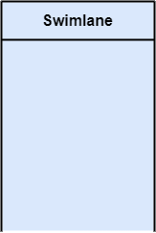
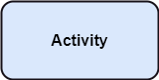
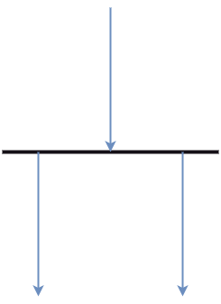
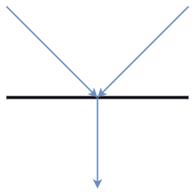
COMPONENTS OF ACTIVITY DIAGRAM
Activities
Activity partition/swimlane
Fork and Join nodes
Pins
Fork Join
Notes:
The control flow of activity is represented by control nodes and object nodes that illustrates the objects used within an activity. The activities are initiated at the initial node and are terminated at the final node.
Activity partition /swimlane
The swimlane is used to cluster all the related activities in one column or one row. It can be either vertical or horizontal. It used to add modularity to the activity diagram. It is not necessary to incorporate swimlane in the activity diagram. But it is used to add more transparency to the activity diagram.
Forks
Forks and join nodes generate the concurrent flow inside the activity. A fork node consists of one inward edge and several outward edges. It is the same as that of various decision parameters. Whenever a data is received at an inward edge, it gets copied and split crossways various outward edges. It split a single inward flow into multiple parallel flows.
Join Nodes
Join nodes are the opposite of fork nodes. A Logical AND operation is performed on all of the inward edges as it synchronizes the flow of input across one single output (outward) edge.
Pins
It is a small rectangle, which is attached to the action rectangle. It clears out all the messy and complicated thing to manage the execution flow of activities. It is an object node that precisely represents one input to or output from the action.

Slide 70
ACTIVITY DIAGRAM NOTATIONS
Initial states: The starting stage before an activity takes place is depicted as the initial state
Final states: The state which the system reaches when a specific process ends is known as a Final State
State or an activity box:
Decision box: It is a diamond shape box which represents a decision with alternate paths. It represents the flow of control.

Slide 71
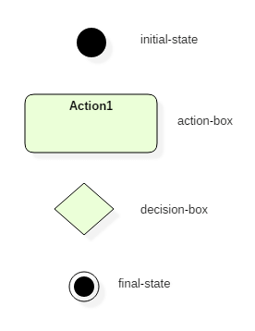

Slide 72
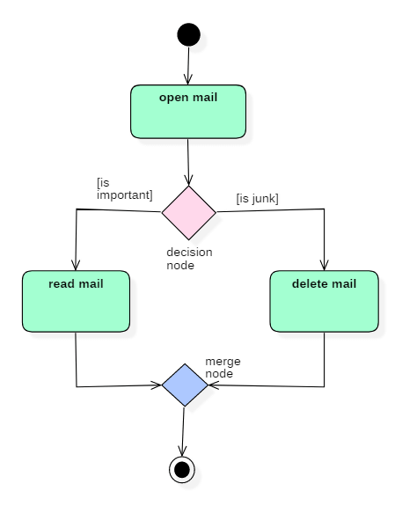
Notes:
Let us consider mail processing activity as a sample for Activity Diagram. Following diagram represents activity for processing e-mails.

Slide 73
STATE CHART DIAGRAM
STATE DIAGRAM are used to capture the behavior of a software system.
UML State machine diagrams can be used to model the behavior of a class, a subsystem, a package, or even an entire system.
It is also called a Statechart or State Transition diagram.
Statechart diagrams provide us an efficient way to model the interactions or communication that occur within the external entities and a system.

Slide 74
There are a total of two types of state machine diagrams:
Behavioral state machine
captures the behavior of an entity present in the system.
represent the specific implementation of an element.
The behavior of a system can be modelled using behavioral state machine diagrams.
Protocol state machine
used to capture the behavior of a protocol.
represents how the state of protocol changes concerning the event.
represents corresponding changes in the system.
do not represent the specific implementation of an element.

Slide 75
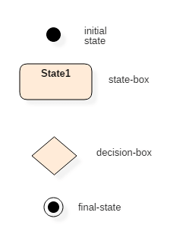

Slide 76
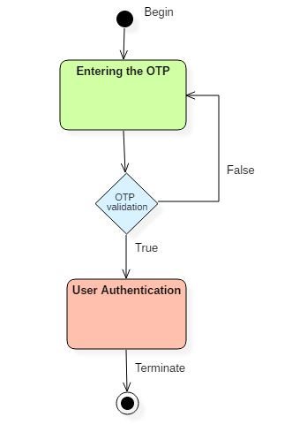
Following state chart diagram represents
the user authentication process.
Notes:
Initial state
The initial state symbol is used to indicate the beginning of a state machine diagram.
Final state
This symbol is used to indicate the end of a state machine diagram.
Decision box
It contains a condition. Depending upon the result of an evaluated guard condition, a new path is taken for program execution.
Transition
A transition is a change in one state into another state which is occurred because of some event. A transition causes a change in the state of an object.
State box
It is a specific moment in the lifespan of an object. It is defined using some condition or a statement within the classifier body. It is used to represent any static as well as dynamic situations.
It is denoted using a rectangle with round corners. The name of a state is written inside the rounded rectangle.
The name of a state can also be placed outside the rectangle. This can be done in case of composite or submachine states. One can either place the name of a state within the rectangle or outside the rectangle in a tabular box. One cannot perform both at the same time.
A state can be either active or inactive. When a state is in the working mode, it is active, as soon as it stops executing and transits into another state, the previous state becomes inactive, and the current state becomes active.
Types of State
Unified Modeling Language defines three types of states:
Simple state
They do not have any substrate.
Composite state
These types of states can have one or more than one substrate.
A composite state with two or more substates is called an orthogonal state.
Submachine state
These states are semantically equal to the composite states.
Unlike the composite state, we can reuse the submachine states.

Slide 77

Introduction to Java

Slide 78
JAVA’S HISTORY
object-oriented programming language with its runtime environment
developed by Sun Microsystems, and it was released in 1995.
James Gosling initially developed Java in Sun Microsystems (which was later merged with Oracle Corporation).
combination of features of C and C++ with some essential additional concepts.
well suited for both standalone and web application development
Notes:
Java is an object-oriented programming language with its runtime environment. It is a combination of features of C and C++ with some essential additional concepts. Java is well suited for both standalone and web application development and is designed to provide solutions to most of the problems faced by users of the internet era.

Slide 79
JAVA PROGRAMMING ENVIRONMENT
Java is a recently developed, concurrent, class-based, object-oriented programming and runtime environment, consists of:
A programming language
An API specification
A virtual machine specification

Slide 80
JAVA RUNTIME ENVIRONMENT(JRE)
The JRE is the software environment, in which programs compiled for a typical JVM implementation can run
platform dependent
JRE includes:
Code necessary to run Java programs, dynamically link native methods, manage memory, and handle exceptions
Implementation of the JVM
JRE – JVM + set of libraries

Slide 81
DEVELOPMENT PLATFORMS -STANDARD, ENTERPRISE
A Java platform is a particular environment in which Java programming language applications run
There are three platforms of the Java programming language:
Java Platform, Standard Edition (Java SE)
Java Platform, Enterprise Edition (Java EE)
Java Platform, Micro Edition (Java ME)
All Java platforms consist of a Java Virtual Machine (JVM) and an application programming interface (API).
The Java Virtual Machine is a program, for a particular hardware and software platform, that runs Java applications.
An API is a collection of software components that you can use to create other software components or applications.

Slide 82
Each Java platform provides a virtual machine and an API,
allows applications written for that platform to run on any compatible system with all the advantages of the Java programming language.

Slide 83
Java SE
Java SE's API provides the core functionality of the Java programming language.
It defines everything from the basic types and objects of the Java programming language to high-level classes that are used for networking, security, database access, graphical user interface (GUI) development.
Java EE
The Java EE platform is built on top of the Java SE platform.
Java EE provides an API and runtime environment for developing and running large-scale applications.

Slide 84
Java ME
The Java ME platform provides an API and a small-footprint virtual machine for running Java programming language applications on small devices, like cellular phones.
The API is a subset of the Java SE API, along with special class libraries useful for small device application development.
JavaFX
JavaFX is a platform for creating rich internet applications

Slide 85
JAVA VIRTUAL MACHINE
JVM is the engine that drives the Java code.
When we compile a Java program, then bytecode is generated.
Bytecode is the source code that can be used to run on any platform.
Bytecode is an intermediary language between Java source and the host system.
It is the medium which compiles Java code to bytecode which gets interpreted on a different machine and hence it makes it Platform/Operating system independent.

Slide 86
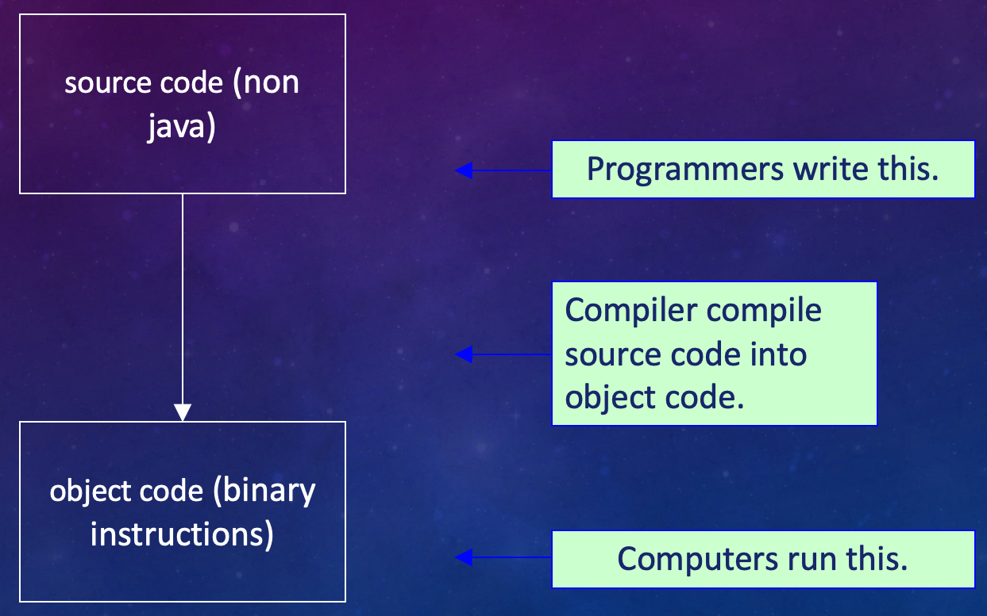
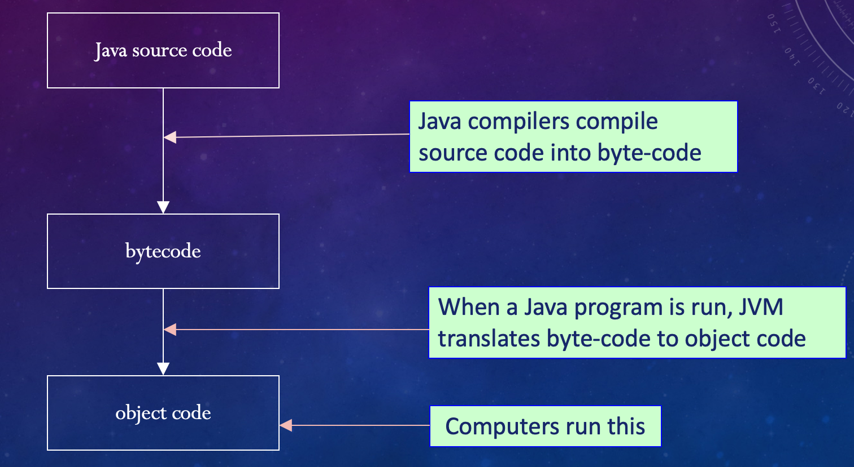
COMPILATION
Non-Java | Java

Slide 87
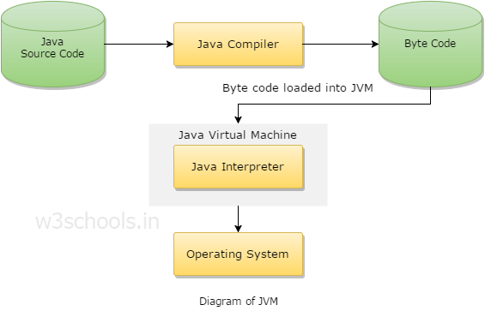
JVM generates a .class(Bytecode) file
file can be run in any OS
JVM should have in OS because JVM is platform dependent
Reading Bytecode
Verifying bytecode
Linking the code with the library

Slide 88
JVM is the main component of Java architecture, and it is the part of the JRE (Java Runtime Environment)
A program of JVM is written in C Programming Language, and JVM is Operating System dependent
JVM is responsible for allocating the necessary memory needed by the Java program
JVM is responsible for deallocating memory space

Slide 89
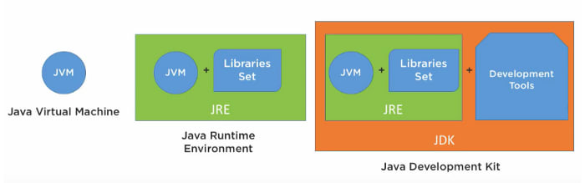
JDK (JAVA DEVELOPMENT KIT)
Just provides environment
To run code
To run code + Programming
It is a full-featured development kit.
JDK has each and every development tool that is required for creating powerful java programs.

Slide 90
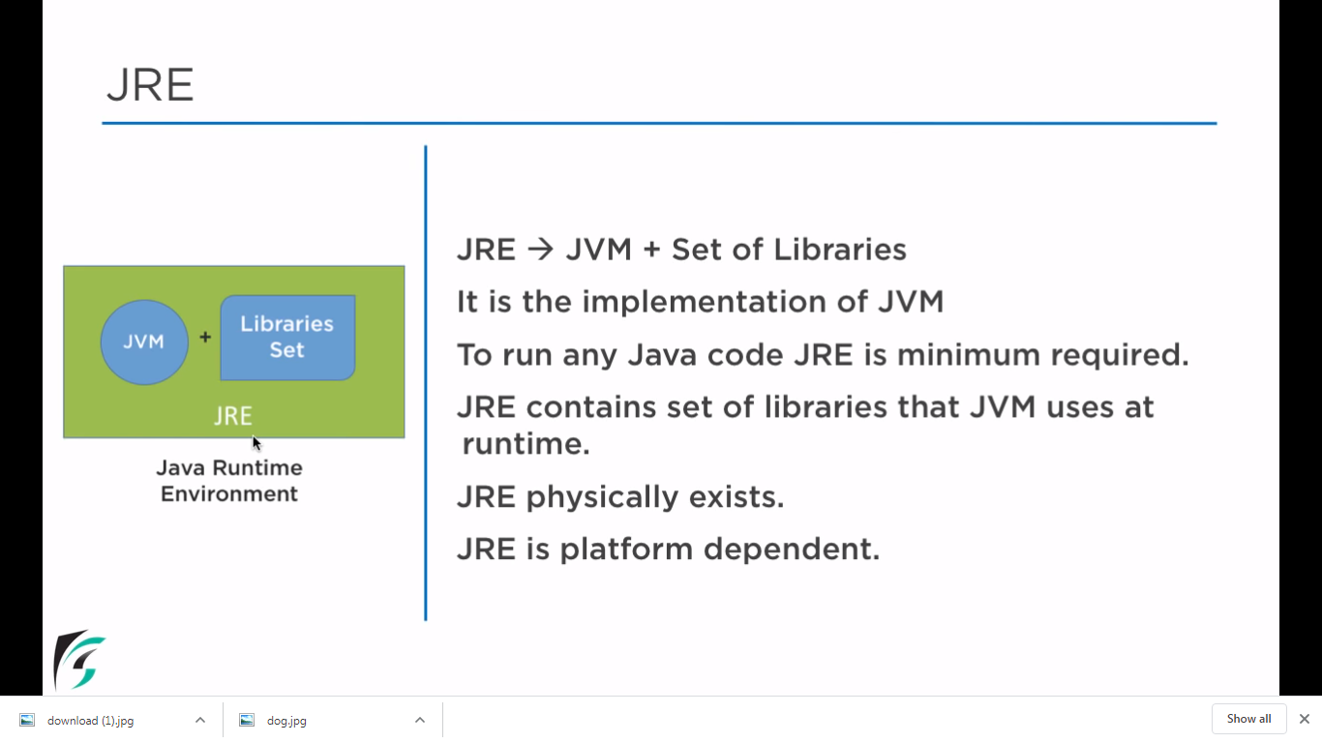

Slide 91
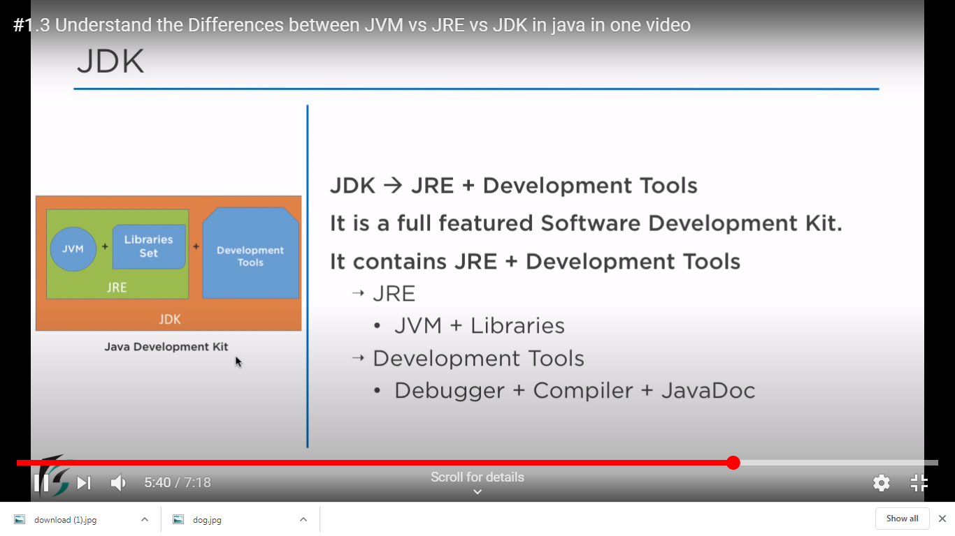

Slide 92
JVM VS JRE VS JDK
JRE is the environment within which the java virtual machine runs. JRE contains Java virtual Machine(JVM), class libraries, and other files excluding development tools such as compiler and debugger.
can run the code in JRE but you can’t develop and compile the code in JRE.
JVM runs the program by using class, libraries and files provided by JRE.
JDK is a superset of JRE, it contains everything that JRE has along with development tools such as compiler, debugger etc.

Slide 93
JAVA APPLICATIONS AND APPLETS
Java can be used to create two types of programs:
An application is a program that runs on your computer, under the operating system of that computer.
An applet is an application designed to be transmitted over the Internet and executed by a Java-compatible Web browser.
It is embedded in HTML page
An applet is a program that can react to user input and dynamically change

Slide 94
JAVA BUZZWORDS
The Java programming language is a high-level language that can be characterized by all of the following buzzwords:
Simple
Object oriented
Distributed
Interpreted
Robust
Secure
Architecture neutral
Portable
High performance
Multithreaded
Dynamic

Slide 95
JAVA BUZZWORDS
Simple
Object oriented
Distributed
Interpreted
Robust
Secure
Architecture neutral
Portable
High performance
Multithreaded
Dynamic
It’s simple and easy to learn if you already know the basic concepts of Object Oriented Programming
C++ programmer can move to JAVA with very little effort to learn

Slide 96
JAVA BUZZWORDS
Simple
Object oriented
Distributed
Interpreted
Robust
Secure
Architecture neutral
Portable
High performance
Multithreaded
Dynamic
Java is true object oriented language.
All program code and data reside within objects and classes.
The object model in Java is simple and easy to extend.
Java comes with an extensive set of classes, arranged in packages that can be used in our programs through inheritance.

Slide 97
JAVA BUZZWORDS
Simple
Object oriented
Distributed
Interpreted
Robust
Secure
Architecture neutral
Portable
High performance
Multithreaded
Dynamic
Java is designed for distributed environment of the Internet.
Its used for creating applications on networks.
Java applications can access remote objects on Internet as easily as they can do in local system.
Java enables multiple programmers at multiple remote locations to collaborate and work together on a single project.

Slide 98
JAVA BUZZWORDS
Simple
Object oriented
Distributed
Interpreted
Robust
Secure
Architecture neutral
Portable
High performance
Multithreaded
Dynamic
Compiled : Java enables creation of a cross platform programs by compiling into an intermediate representation called Java Bytecode.
Interpreted : Bytecode is then interpreted, which generates machine code that can be directly executed by the machine that provides a Java Virtual machine.

Slide 99
JAVA BUZZWORDS
Simple
Object oriented
Distributed
Interpreted
Robust
Secure
Architecture neutral
Portable
High performance
Multithreaded
Dynamic
It provides many features that make the program execute reliably in variety of environments.
Java is a strictly typed language. It checks code both at compile time and runtime.
Java takes care of all memory management problems with garbage-collection.

Slide 100
JAVA BUZZWORDS
Simple
Object oriented
Distributed
Interpreted
Robust
Secure
Architecture neutral
Portable
High performance
Multithreaded
Dynamic
Java provides a “firewall” between a networked application and your computer.
When a Java Compatible Web browser is used, downloading can be done safely without fear of viral infection or malicious intent.
Java achieves this protection by confining a Java program to the java execution environment and not allowing it to access other parts of the computer

Slide 101
JAVA BUZZWORDS
Simple
Object oriented
Distributed
Interpreted
Robust
Secure
Architecture neutral
Portable
High performance
Multithreaded
Dynamic
Platform Independent
Java code is compiled by the compiler and converted into bytecode
This bytecode is platform independent because it can be run on multiple platforms with a Java Virtual Machine (JVM).
Write Once and Run Anywhere(WORA).

Slide 102
JAVA BUZZWORDS
Simple
Object oriented
Distributed
Interpreted
Robust
Secure
Architecture neutral
Portable
High performance
Multithreaded
Dynamic
Because Java is architecture neutral, Java programs are portable.
They can be run on any platform without being recompiled.

Slide 103
JAVA BUZZWORDS
Simple
Object oriented
Distributed
Interpreted
Robust
Secure
Architecture neutral
Portable
High performance
Multithreaded
Dynamic
Java performance is high because of the use of bytecode.
The bytecode is used, so that it was easily translated into native machine code.

Slide 104
JAVA BUZZWORDS
Simple
Object oriented
Distributed
Interpreted
Robust
Secure
Architecture neutral
Portable
High performance
Multithreaded
Dynamic
Multithreaded Programs handles multiple tasks simultaneously, which is helpful in creating interactive, networked programs.
Java run-time system comes with tools that support multiprocess synchronization used to construct smoothly interactive systems.

Slide 105
JAVA BUZZWORDS
Simple
Object oriented
Distributed
Interpreted
Robust
Secure
Architecture neutral
Portable
High performance
Multithreaded
Dynamic
Java is capable of linking in new class libraries, methods, and objects
It can also link native methods (the functions written in other languages such as C and C++)

Slide 106
JAVA COMMENTS
Why Comments?
pieces of text notes that are added to a program in order to describe something about the program or provide any information
comments make the programs more human readable and easier to understand
any statement written as comments is non-executable.
compiler and interpreter ignore these statements while compiling the program.
do not affect the flow of the program or the output.

Slide 107
Uses of Comments
Code Description
Information about the Source Code
Planning and Debugging
Automatic documentation generation
Types of Comments in Java
Single line Comment:
// This represents a single line Comment
Multi-line Comment:
/* This is multi-line comment statement 1
This is multi-line comment statement 2 */

Slide 108
Documentation Comment: doc comments above the methods or classes which we want to document.
JDK Javadoc tool uses these doc comments to automatically prepare documentation of the source code.
This comment is very much similar to multi-line comment except for an extra “*”.
/** This represents documentation comments.
This is Javadoc
@author Ipsita
**/

Slide 109
JAVA GARBAGE COLLECTION
In java, garbage means unreferenced objects
process of reclaiming the runtime unused memory automatically
a way to destroy the unused objects
free() function in C language and delete() in C++
in java it is performed automatically --> better memory management
Advantage of Garbage Collection
It makes java memory efficient because garbage collector removes the unreferenced objects from heap memory.
It is automatically done by the garbage collector

Slide 110
UNREFERENCED OBJECTS
By nulling the reference
med p = new med();
p = null;
By assigning a reference to another
med q=new med();
med r=new med();
q=r; //now the first object referred by q is available for garbage collection
By anonymous object
new med();

Slide 111
LEXICAL ISSUES
Java programs is a collection of White spaces, Identifiers, comments, Literals, Operators, Separators & Keywords.
Compilation, characters 🡪 series of tokens
1.Whitespace
java is a free-form language.
need not follow any special indentation rules.
program could have been written all on one line or in any other strange way you felt like typing it, as long as there was at least one whitespace character between each token that was not already delineated by an operator or separator
whitespace is a space, tab, or newline

Slide 112
2. Identifiers
Identifiers are used to name things, such as classes, variables, and methods.
An identifier may be any descriptive sequence of up of uppercase and lowercase letters, numbers, or the underscore and dollar-sign characters.
must not begin with a number, lest they be confused with a numeric literal.
Java is case-sensitive, so VALUE is a different identifier than Value.
Valid 🡪 AvgTemp, count, a4, $test, this_is_ok
Invalid🡪 2count, high-temp, Not/ok
3. Literals A constant value in java is created by using a literal representation of it.
A literal can be used anywhere a value of its type is allowed.
100, 98.6, ‘X’, “This is a test”

Slide 113
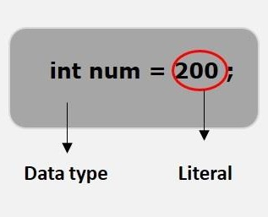
4. Separators
few characters that are used as separators.
commonly used separator in Java is the semicolon, it is used to terminate statement

Slide 114
Symbol | Name | Purpose
() | Parentheses | Used to contain lists of parameters in method definition and invocation, defining precedence in expressions, containing expressions in control statements, and surrounding cast types.
{} | Braces | Used to contain the values of automatically initialized arrays, used to define a block of code, for classes, methods, and local scopes.
[] | Brackets | Used to declare array types, used when dereferencing array values.
; | Semicolon | Terminates statements.
, | Comma | Separates consecutive identifiers in a variable declaration, used to chain statements together inside a for statement.
. | Period | Used to separate package names from subpackages and classes. Also used to separate a variable or method from a reference variable.

Slide 115
5. The Java Keywords
There are 50 keywords currently defined in the Java language
keywords, combined with the syntax of the operators and separators, form the foundation of the Java language.
cannot be used as identifiers.
cannot be used as names for a variable, class, or method.

Slide 116
abstract | continue | for | new | switch
assert | default | goto | package | synchronized
boolean | do | if | private | this
break | double | implements | protected | throw
byte | else | import | public | throws
case | enum | instanceof | return | transient
catch | extends | int | short | try
char | final | interface | static | void
class | finally | long | strictfp | volatile
const | float | native | super | while

Slide 117
BASIC STRUCTURE OF JAVA PROGRAM
Documentation Section
Package Statement
Import Statements
Interface Statement
Class Definition
Main Method Class
Main Method Definition

Slide 118
Documentation Section | Optional/can write a comment in this section. Comments are beneficial for the programmer because they help them understand the code.
Package statement | can create a package with any name. package is a group of classes that are defined by a name. to declare many classes within one element, then you can declare it within a package. optional part of the program, package is a keyword that tells the compiler that package has been created🡪package package_name;
Import statements | to use a class of another package, import it directly into your program🡪import calc.add;

Slide 119
Interface statement | Interfaces are like a class that includes a group of method declarations. optional section can be used when programmers want to implement multiple inheritances within a program.
Class Definition | A Java program may contain several class definitions. Classes are the main and essential elements of any Java program.
Main Method Class | Every Java stand-alone program requires the main method as the starting point of the program. This is an essential part of a Java program. There may be many classes in a Java program, and only one class defines the main method. Methods contain data type declaration and executable statements.

Slide 120
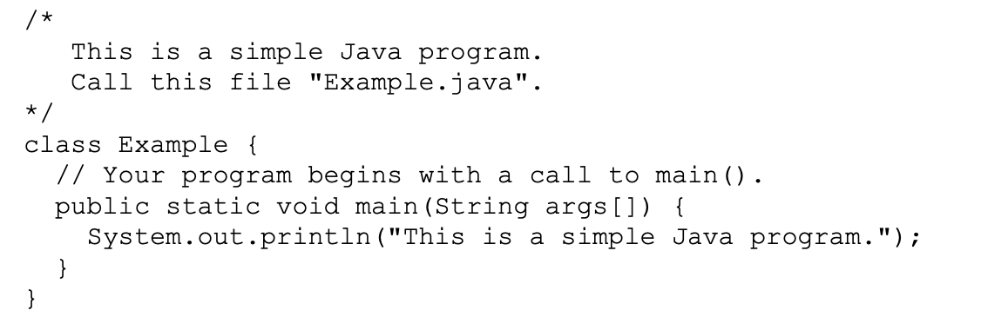
FIRST SIMPLE JAVA PROGRAM
To compile:
javac Example.java
To run:
java Example
Note : - Set Environment variables – To run java programs anywhere
Set path to JDK bin directory
set path=C:\Program Files\Java\jdk1.8.0_31\bin

Slide 121
class Example | This creates a class called Example All class names must start with a capital letter
/* Comments */ | The compiler ignores comment block Comment can be used anywhere in the program to add info about the program or code block, which will be helpful for developers to understand the existing code in the future easily
Braces | Two curly brackets {...} are used to group all the commands, so it is known that the commands belong to that class or method.
public static void main | When the main method is declared public, it means that it can also be used by code outside of its class, due to which the main method is declared public. The word static used when we want to access a method without creating its object, as we call the main method, before creating any class objects. The word void indicates that a method does not return a value. main() is declared as void because it does not return a value. main is a method; this is a starting point of a Java program, is the entry point method from which the JVM can run your program. main method code has been moved to some spaces left. indentation which used to make a program easier to read and understand.

Slide 122
String[] args | It is an array where each element of it is a string, which has been named as "args". If your Java program is run through the console, you can pass the input parameter, and main() method takes it as input.
System.out.println(); | This statement is used to print text on the screen as output, where the system is a predefined class, and out is an object of the PrintWriter class defined in the system. The method println prints the text on the screen with a new line. You can also use print() method instead of println() method. All Java statement ends with a semicolon.

Slide 123
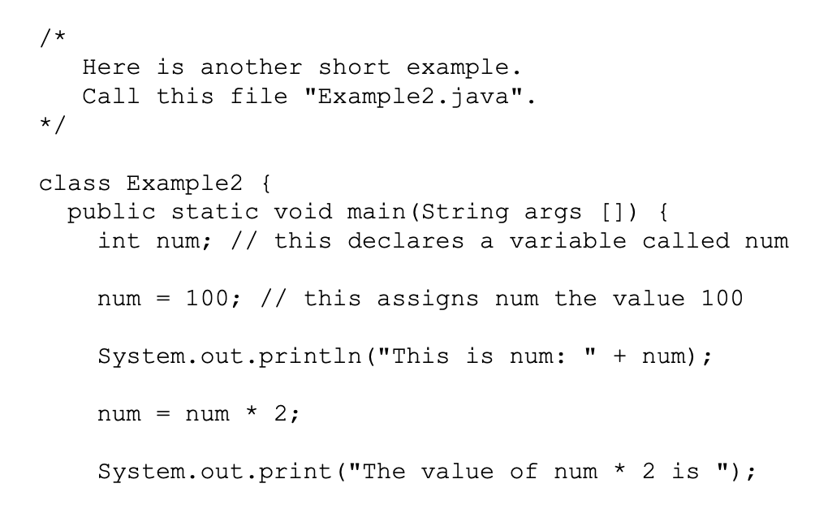
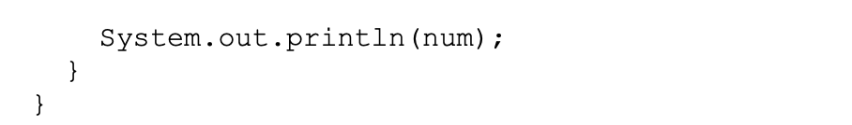


Slide 124
class JavaTester
{
public static void main(String[] args)
{
System.out.print("Hello");
System.out.print("World");
}
}
class JavaTester
{
public static void main(String[] args)
{
System.out.println("Hello");
System.out.println("World");
}
}

Slide 125
POINTS TO PONDER
Java is CASE SENSITIVE.
File name has to be the same as class name in file.
Need to import necessary class definitions
All statements in Java end with a semicolon.
Whitespace is ignored by compiler
In Java, all code must reside inside a class.

Slide 126



Two Control Statements
1. if(condition) statement;
Eg: if(num < 100)
System.out.println("num is less than 100");

Slide 127

2. The for Loop
for(initialization; condition; iteration) statement;

Slide 128
Work out first program , second program and program to differentiate print and println.
Work out on If loop & for loop

Slide 129
THANKYOU

